Slide 1
Supporting our Students in Safe and Secure Environments
HIB & Suicide Prevention
August 6, 2015

Slide 2
Outcomes
After the presentation you will:
  Be aware of current Healthy Youth Survey data regarding HIB and mental health
  Be aware of resources available to your school to support student mental health
  Be able to plan for staff and student training

Slide 3
HIB

Slide 4
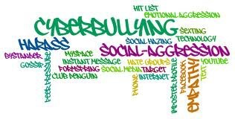
Why We Need to Discuss HIB
Important topic in society today
  Cyberbullying major issue for kids; impacts to school environment
Legal challenges around the state
Claims against Everett Public Schools in 2014-2015

Slide 5
Policy/Procedure/Law
3204/3204P
RCW 28A.300.285
  Defines HIB
  Requires compliance officer, staff and student training, investigation, timeline

Slide 6
Definition
Bullying is unwanted, aggressive behavior among school aged children that involves a real or perceived power imbalance. The behavior is repeated, or has the potential to be repeated, over time. Bullying includes actions such as making threats, spreading rumors, attacking someone physically or verbally, and excluding someone from a group on purpose.

Slide 7
A Relational Problem
Bullying is a relationship problem that requires a relationship solution.
Notes:
Citation (9)

Slide 8
Core Elements
Bullying is a form of youth violence that includes:
Unwanted, aggressive behavior
A real or perceived imbalance of power between the student(s)/adult(s) doing the bullying and the student(s) being bullied
Behavior that is repeated, or has the potential to be repeated, over time

Slide 9
Who Harasses/Bullies?
Teachers/Coaches/Other Adults
  Investigated 2 cases in past two years
Affluent students
  Used to getting own way
  Looked up to by other students/has influence
Disadvantaged students
  Lack control of life
  Trying to find place in world

Slide 10
Roles in Harassment
Aggressor
Target
Bystanders
  Bystanders can be taught to be UP-STANDERS to change the climate

Slide 11
When Do Kids Reveal Bully Troubles?
Video – Rosalind Wiseman
A story about a kid.

Slide 12
2014-15 EPS Discipline Data
 | Elementary | Middle | High
Bullying/ Other Harassment | 26 | 185 | 105
Disability | 0 | 0 | 1
Racial | 2 | 17 | 7
Sexual | 7 | 54 | 17
Total | 35 | 256 | 130
Not all incidents reported

Slide 13
Comparison Data HYS 2008-2014
Percent of Students Who Report Being Bullied
in the Past 30 Days

Slide 14
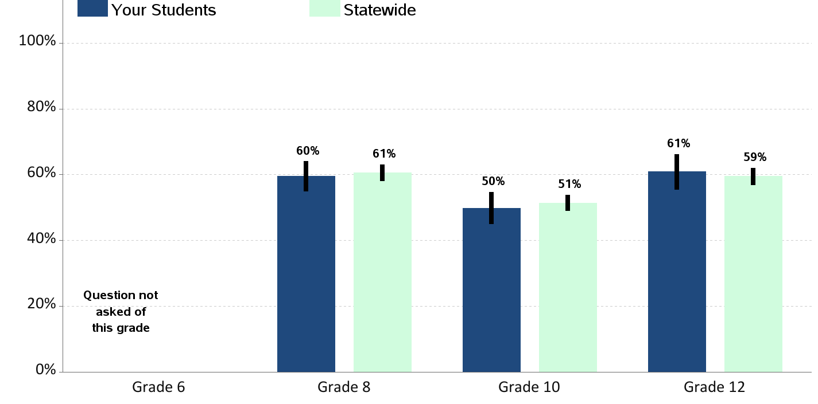
2014 HYS Data
Percent of Students Who Report Teachers or Other Adults
at School “Almost Always” or “Often” Try to Stop Bullying

Slide 15
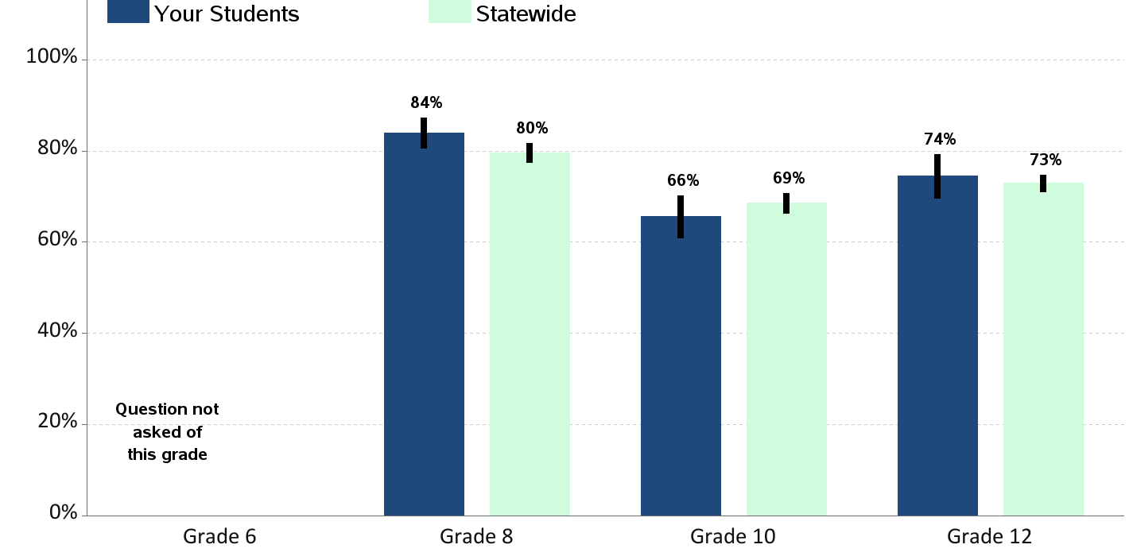
2014 HYS Data
Percent of Students Who Report
They Know How to Report Bullying at School

Slide 16
Supportive Settings
Engagement: includes relationships, respect for diversity, and school participation
Environment: includes the physical, academic, and disciplinary environments and wellness
Safety: includes emotional and physical safety and reduction of substance use

Slide 17
Best Practices in Bullying Prevention and Intervention
Focus on the social environment of the school
Assess bullying at your school.
Garner staff and parent support for bullying prevention.
Form a group to coordinate the school’s bullying prevention activities.
Train your staff in bullying prevention and keep talking about it.
Establish and enforce school rules and policies related to bullying.
Increase adult supervision in hot spots where bullying occurs.
Intervene consistently and appropriately in bullying situations.
Focus some class time on bullying prevention throughout the year.
Continue these efforts over time.
www.stopbullyingnow.hrsa.gov

Slide 18
You are Doing Good Things
Share one thing your school is doing to develop a healthy, respectful school climate

Slide 19
Mental health

Slide 20
House Bill 1336
A 3 hour Suicide Prevention Training is required of school counselors, psychologists, and social workers.
School districts are required to adopt a crisis response plan for recognition, initial screening and response to emotional or behavioral distress in students.
Notes:
Including suicidal thinking, behavior, ad threats of violence. This will help districts and schools respond quickly and effectively in a crisis. Refer to OSPI website.

Slide 21
Comparison Data HYS 2008-2014
Percent of Students Who Report Experiencing Depressive
Feelings in the Past Year

Slide 22
Comparison Data HYS 2008-2014
Percent of Students Who Report Having Seriously
Considered Suicide in the Past Year

Slide 23
Networks for Life:
A Counselor’s Role in Youth Suicide Prevention
    About Youth Suicide
    Prevention: Knowing the Issue
    Youth Suicide in Washington: Data
    Prevention Education
    Prevention: Creating a supportive, preventive environment
    Intervention: When to step in
    Postvention: After a suicide
Notes:
Content includes background and awareness, prevention strategies, identifying and intervening in signs of depression and suicidal thinking, resources
Content on special population issues for many youth populations
Versions tailored to the audience for:
Students
Parents of teens
Educators
School counselors, nurses, and psychologists
Mental health providers
Others by request

Slide 24
Signs of Suicide Curriculum for Middle School and High School
Signs of Suicide is the only evidence and school-based suicide prevention program endorsed by SAMHSA.
Addresses suicide risk and depression, reduces suicide attempts, empowers students with practical tools, educates students, parents and staff and creates common mental health language.
Can be delivered in one or two class periods.
Easy and simple to use.

Slide 25
Signs of Suicide Curriculum
Video creates structure to address mental health concerns in a consistent and healthy manner.
Gives students the language and opportunity to ask for help when they normally would not have.
Addresses and reinforces previous lessons regarding bullying, on-line safety, depression and self-harm.

Slide 26
Time to Act: SOS Signs of Suicide Middle and High School Program
https://www.youtube.com/watch?v=CRjAm3b-e_w
https://www.youtube.com/watch?v=hhuUCVbejus
Notes:
"Time to ACT" is the main educational component of the SOS Signs of Suicide Middle School Program. The educational DVD features various scenes and educational vignettes to model responding to a friend in need using the ACT technique. Acknowledge that there is a problem; let your friend know that you Care; then Tell a trusted adult. For more information visit: http://www.MentalHealthScreening.org/SOS
SOS Signs of Suicide® Prevention program is an award-winning, nationally recognized program designed for middle and high school-age students. The program teaches students how to identify the symptoms of depression and suicidality in themselves or their friends, and encourages help-seeking through the use of the ACT® technique (Acknowledge, Care, Tell).

Slide 27
Program and Curriculum Resources
The following are links to information on bullying prevention and intervention background, educator and parent resources and programs.
Bullying Prevention Resources (PDF)
Committee for Children: Provides many resources for bullying prevention. This site can guide the selection of a bullying prevention program by the bullying prevention committee.
Community Matters: Programs and services organized around a whole-school framework to improve school climate and reduce bullying related incidents.
Let’s Get Real: Young people tell their stories in their own words–and the results are heartbreaking, shocking, inspiring and poignant.
The Massachusetts Aggression Reduction Center: MARC provides academic-based, high-quality, free or low cost programs, research and resources for education, communities and families, nationwide.
Olweus Bullying Prevention Program - A comprehensive, school-wide program designed and evaluated for use in elementary, middle, junior high or high schools.
Pacer’s National Bullying Prevention Center: Unites, engages and educates communities nationwide to address bullying through creative, relevant and interactive resources.
Peaceful Playgrounds: The purpose is to introduce children and school staff to the many choices of activities available on playgrounds and field areas

Slide 28
Program and Curriculum Resources
Positive Behavioral Interventions and Supports: A decision making framework that guides selection, integration, and implementation of the best evidence-based academic and behavioral practices for improving important academic and behavior outcomes for all students.
Project Adventure: The Peaceable Playground Program was developed by Project Adventure to address aggressive play at recess.
Rachel’s Challenge: A series of student empowering programs and strategies that equip students and adults to combat bullying and ally feelings of isolation and despair.
Safe & Civil Schools: A series of materials and services that schools and districts can use to implement Positive Behavior Support solutions.
Seattle MS Cyberbullying Curriculum: Lessons can be used alone, but contain materials designed to coordinate with and fit into ongoing Olweus Bullying Prevention programs.
StopBullying.gov: Provides information from various government agencies on what bullying is, what cyberbullying is, who is at risk, and how you can prevent and respond to bullying.
Teaching Tolerance: A place for educators to find thought-provoking news, conversation and support for those who care about diversity, equal opportunity and respect for differences in schools.
http://www.k12.wa.us/Safetycenter/BullyingHarassment/default.aspx

Slide 29
Now it’s your turn…
Spend the next ____ minutes in your school team planning the activities and strategies you will implement in your building this year that specifically address supporting our students in safe and secure social and emotional environments.

Slide 30
A little inspiration…
https://www.youtube.com/watch?v=m5yCOSHeYn4

